Slide 1






UniEats
Solving Campus
Food Problems
Muhereza Daniel | S24BBUC/BSIT/012

Slide 2
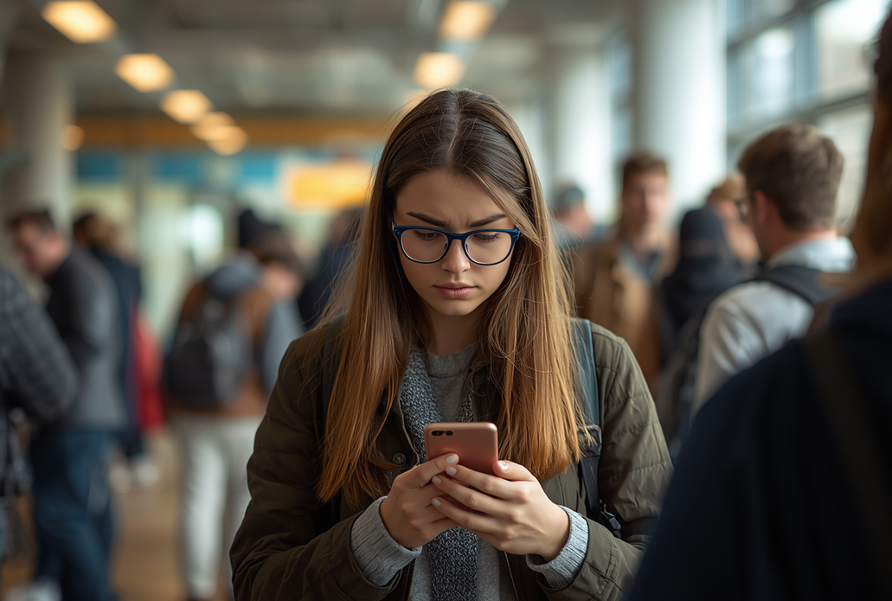
THE PROBLEM
BBUC students struggle with limited food options on campus. Our interviews revealed key pain points: long queues during peak hours, lack of menu visibility, and no way to pre-order meals. 78% of students surveyed skip meals due to time constraints between classes.

Slide 3

QR CODE ACCESS
Scan the QR code on any campus poster to instantly access UniEats - no app download required. Works on any smartphone browser for immediate, frictionless access.
SOLUTION
CORE FEATURES
UniEats is a web app designed specifically for BBUC students to solve the campus food discovery problem identified through student interviews and validation research.
Browse all campus food vendors in one place. View real-time menus, prices, and wait times. Place orders for pickup or delivery. Rate and review your dining experiences.
PROBLEM SOLVED
Students reported difficulty finding food options and long queues. UniEats centralizes vendor information, reduces wait times through pre-ordering, and helps students make informed choices.

Slide 4



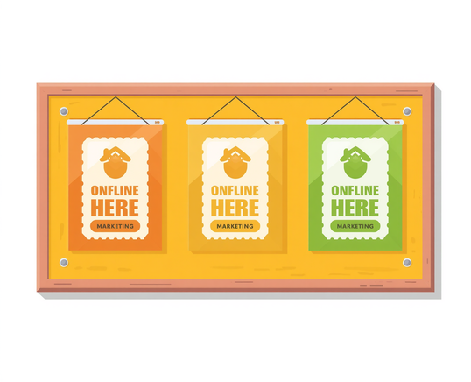
BRAND IDENTITY
UniEats brand is built on trust, convenience, and campus community. Our visual identity uses vibrant orange and fresh green to evoke appetite and sustainability.
Brand Colors
Brand Voice
Orange & Green
Friendly & Local
Social Media
Campus Posters
Channel 1
Channel 2

Slide 5

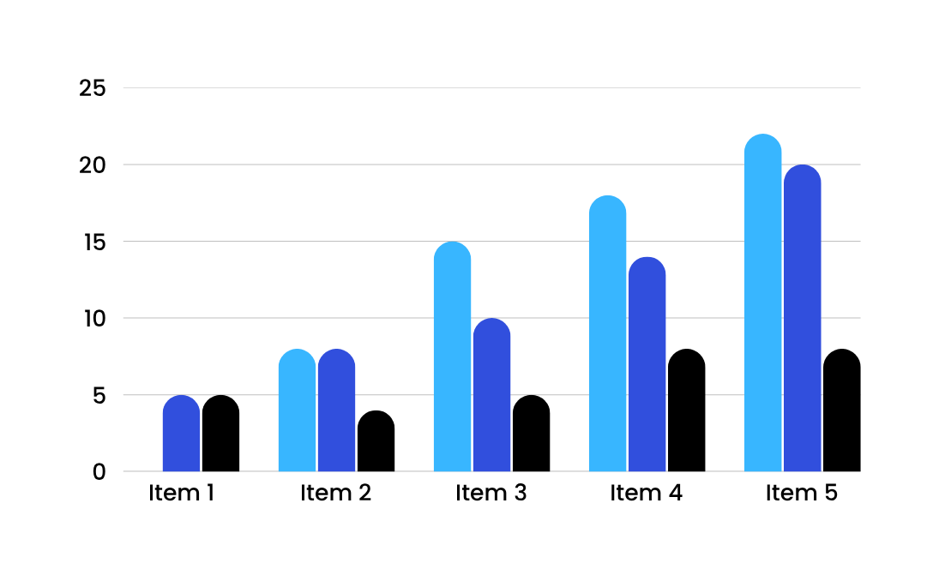
REVENUE STREAMS
UniEats generates revenue through two primary channels: a delivery fee per order and a listing fee for vendor partnerships. This dual-stream model ensures sustainable growth while keeping costs affordable for students.

Slide 6
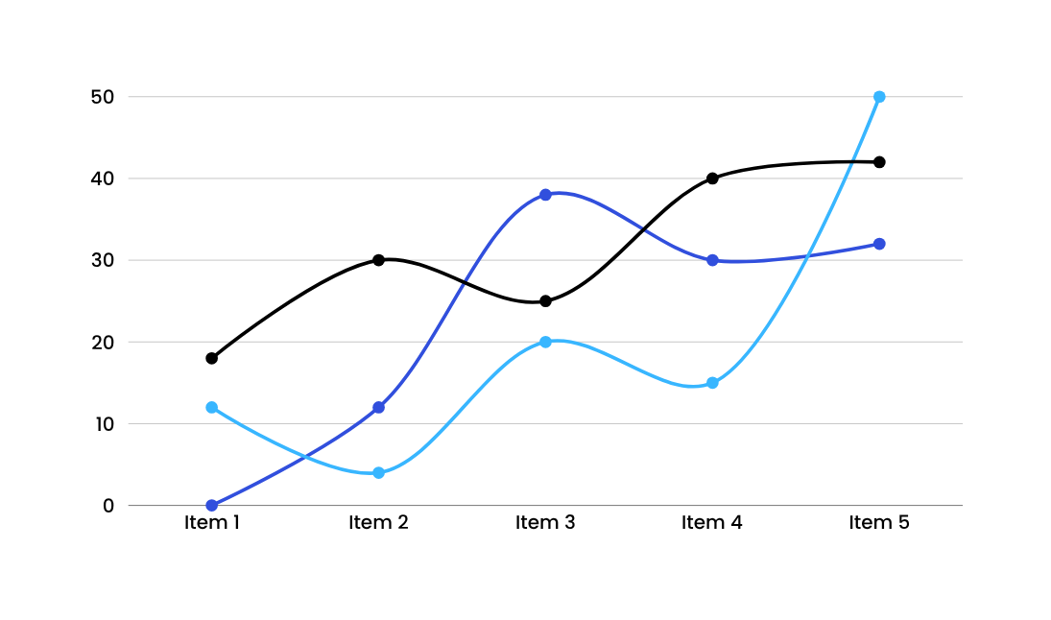
3-MONTH TARGET KPIS
Our key performance indicators track growth across three critical metrics: user acquisition targeting 500 active users by month 3, order volume aiming for 1,000 monthly orders, and revenue projections of £2,500 monthly from delivery and listing fees combined.

Slide 7




OUR UNIQUE VALUE PROPOSITION
No existing campus solution. Built by a BBUC student, for BBUC students. UniEats fills a gap that no other service addresses—bringing convenient, affordable food delivery directly to our campus community.

Slide 8
ANTICIPATED Q&A
Scalability
Modular architecture for growth
Competition
No campus-specific solution exists
Payment Security
SSL encryption & secure gateways
Canteen Partnerships
Win-win revenue sharing model
Profitability Timeline
Break-even within 6 months

Slide 9
THANK YOU
QUESTIONS WELCOME!

